Slide 1

IST 303: Creating a Raster Function (RFx) Site to facilitate ArcGIS development
Milestone 1:
Introduction (Motivation).
Scrum (user story, burndown, velocity).
Data.
Methods.
Current progress.
Aote, Akhilesh, Mohammed

Slide 2
Introduction
Our project had the longest brainstorming process.
It involves creating a web app that provides database capabilities.
This webpage tracks changes to raster functions in ArcGIS over time. It's an accessible platform to view function modifications, requirements, and developers. It makes it easier to understand changes to raster functions and access relevant information.
This tool aims to enhance access to information, streamline collaboration, and improve usage efficiency for those working with ArcGIS Pro's raster functions.
Keywords:
ArcGIS.
Database webpage.
Raster functions.
GIS development.
Ownership Tracking.
And development coordination.

Slide 3
Stakeholders: The Pillars of Our Project's Success
Recognize and engage all critical participants in the project. The primary stakeholders are (end users) such as:
dedicated Imagery/Raster team at Esri.
any other teams within Esri that utilize raster functions for their projects.
Additional:
Quality assurance teams.
Training teams.
External partners and developers.
These groups form the cornerstone of our initiative, representing a collaboration of expertise and application that drives innovation within the geospatial domain.

Slide 4

User Journeys: Shaping the Next Gen of Raster Functionality
These are samples of the initial set of our project requirements expressed as user:
As a user, I want to have a database of all raster functions and their parameters in all the previous ArcGIS Pro releases. TE 1 week.
As a user, I want to have a Tool owner page that allows me to assign a raster function to a function owner. TE: 1 week.
As a user, I want to be able to search, filter and update based on rfx name, owner name on the tool owner page. TE: 1 week.
As a user, I want to be able to compare 2 releases and see if there are functions, parameters added or removed from one version of the software. TE: 1 week.

Slide 5
Blueprint for Success: What Works in Our Project
Streamlined Data Preparation.
Using ADRasterRegistry.xml standardizes initial raster function data for accuracy and consistency.
Efficient Data Transformation.
Raster function info can be flexibly managed by converting it from XML to JSON format. Organizing data into a three-tier hierarchy improves navigation and usability.
Advanced-Data Storage Solutions.
JSON for flexible storage of nested data. CSV table for tracking raster function ownership.
User-Centric Design.
A page with advanced filtering and search makes finding raster functions easy, improving user experience.
Collaborative Framework.
Establishing a clear, accessible database of raster function ownership encourages collaboration within and potentially outside the team, streamlining project development and support processes.
Key Insights:
Emphasizing flexible data management and user-friendly interfaces promotes efficiency and user satisfaction.
The structured yet adaptable approach to data storage and organization underpins the project's success, proving the value of clear planning and execution.

Slide 6
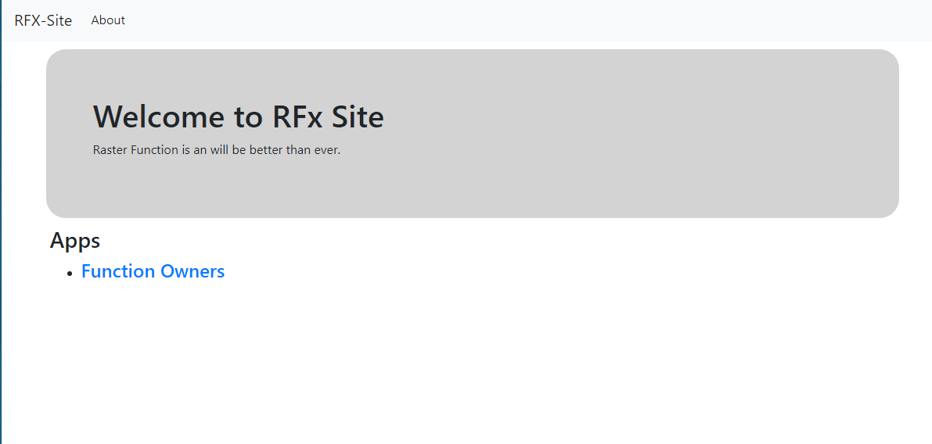
Examples of what works 1

Slide 7
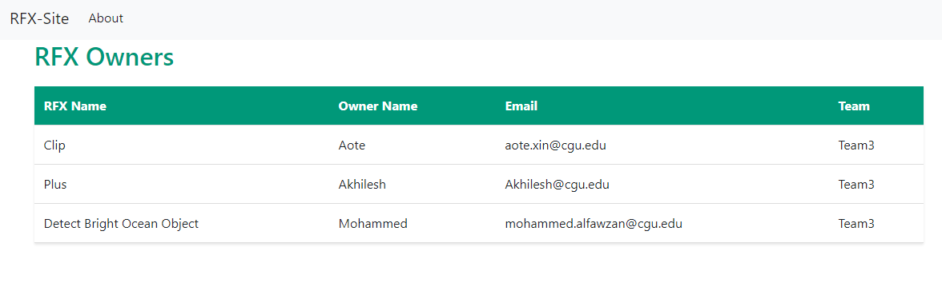
Examples of what works 2

Slide 8
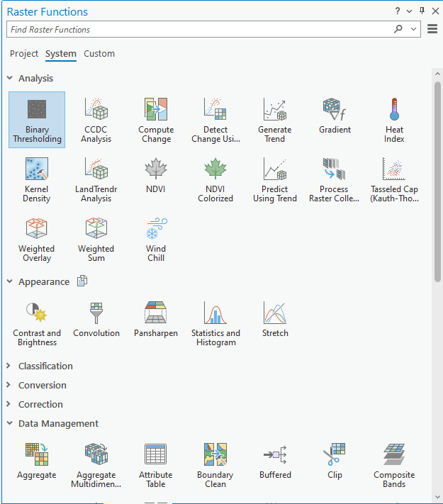
Examples of what works 3

Slide 9

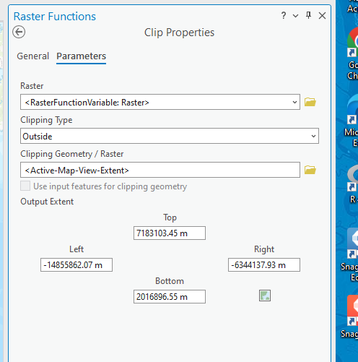
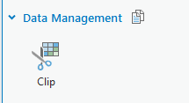
Examples of what works 4

Slide 10
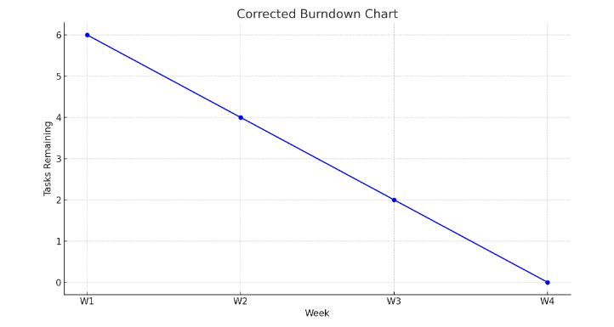
How it works?
Actual code and website illustrated >>>
Notes:
Remaining tasks: Velocity, Burndown charts.
Create bogus .xml data and run the rfx_info_to_json.py script to create "rfx_infoArcGISPro_33_51289" under rfx_info directory.
0. Data preparation
1. Create Bogus data for XML format file (ADRasterRegistry.xml) which contains the info about rfx.
2. creae a table that hold rfx owners on the page

